Slide 1
FILARIAL NEMATODES
Dr. R.S.G.SOWMYA,
Assistant Professor
Dept of Pathology, SKHMC, kulasekharam

Slide 2
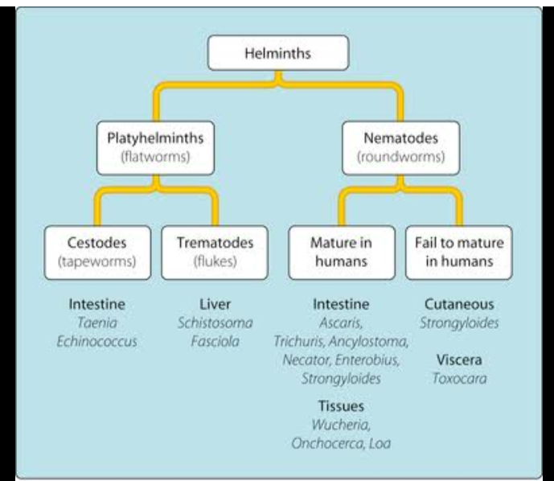

Slide 3
Helminths are multicellular, bilaterally symmetrical animals
Helminths – 2 Phylum
Platyhelminthes - Cestodes & Trematodes
Nemahelminthes - Nematodes

Slide 4
Differences between Cestodes, Trematodes & Nematodes
 | CESTODES | TREMATODES | NEMATODES
Shape | Tape like segmented | Leaf like unsegmented | Elongated, cylindrical, unsegmented
Sexes | Sexes not separate Monoecious Hermaphrodite | Sexes not separate Monoecious except Schistosoma | Sexes are separate Diecious
Head end | Suckers, often with hooks | Suckers, no hooks | No suckers, no hooks, well developed
Alimentary canal | Absent | Present, incomplete, no anus | Present, complete, anus present
Body cavity | Absent | Absent | Present
8/31/2017
4

Slide 5
NEMATODES CLASSIFICATION
(LOCATION OF ADULT IN BODY)
INTESTINAL NEMATODES:
Small intestine: Ascaris, Ancylostoma, Necator, Strongyloides, Trichinella.
Large intestine: Enterobius, Trichuris
TISSUE NEMATODES (Somatic nematodes):
Lymphatic: Wuchereria, Brugia
Sub-cutaneous: Loa loa, Onchocerca, Dracunculus
Mesentry: Mansonella spp.,
Conjucntiva: Loa loa
Zoonotic filariasis: Dirofilaria spp.,

Slide 6
NEMATODES CLASSIFICATION
(MODE OF INFECTION)
i. By ingestion:
Eggs: Ascaris, Enterobius, Trichuris
Larvae within intermediate host: Dracunculus
Encysted larvae in the muscle: Trichinella
By Penetration of Skin: Ancylostoma, Necator,
Strongyloides
By blood sucking insects: Filariae
By inhalation of dust containing eggs: Ascaris, Enterobius

Slide 7
NEMATODES CLASSIFICATION
(BASED ON THEY LAY EGGS/LARVAE)
i. Oviparous: Egg laying nematodes
Unsegmented eggs: Ascaris, trichuris
Segmented eggs: Ancylostoma, Necator
Eggs containing larvae: Enterobius
Viviparous: Producing larvae
Ex: Trichinella, Wuchereria, Brugia, Dracunculus
Ovoviviparous: Laying eggs containing fully formed larvae which hatch out immediately: Strongyloides.

Slide 8
HUMAN FILARIAL WORMS
Filarial worms belong to Superfamily: Filarioideae.
Thread like worms transmitted by blood sucking insects (Arthropods)
Vector borne disease / Zoonotic disease
Infection by any filarial worm is called as ‘Filariasis’.
Morphological forms: Adult worm & Microfilariae (embryo)

Slide 9
HUMAN FILARIAL WORMS
Microfilaria (mf): Sheathed & Unsheathed/naked
Sheathed mf: Retain their egg membrane
Unsheathed mf: Ruptures out from the egg membranes
8 species of filarial worms infect humans
Humans are the Definite hosts

Slide 10
Classification of Human filarial worms
Lymphatic filariasis:
  Wuchereria bancrofti (Bancroftian filariasis)
  Brugia malayi (Malayan filariasis)
  Brugia timori
Subcutaneous filariasis:
  Loa loa (Calabar swelling/Fugitive swelling)
  Onchocerca volvulus (River blindness, dermatitis) &
  Mansonella streptocerca (Skin diseases)
Serous cavity filariasis:
  Mansonella ozzardi (Non-pathogenic) &
  Mansonella perstans (Non-pathogenic)

Slide 11
Classification of Human filarial worms
D. Zoonotic filariasis:
Dirofilaria immitis
Dirofilaria repens
Brugia pahangi
Brugia beaveri
Brugia leporis

Slide 12
Filarial nematode | Habitat of Adults | Habitat of Microfilaria |  | Vector | Microfilaria periodicity
LYMPHATIC FILARIASIS
Wuchereria bancrofti | Lymphatic tissue | Blood |  | Culex quinquefasciatus (W) Anopheles in rural Africa Aedes spp., | Nocturnal (M) Sub-periodic (R)
Brugia malayi | Lymphatic tissue | Blood |  | Mansonia spp., Anopheles Mansonia spp., Coquillettidia | Nocturnal (M) Sub-periodic (R)
Brugia timori | Lymphatic tissue | Blood |  | Anopheles barbirostris | Nocturnal
SUBCUTANEOUS FILARIASIS
Loa loa | Subcutaneous tissue, Conjunctiva | Blood | Chrysops (Deer fly) |  | Diurnal
Onchocerca volvulus | Subcutaneous tissue | Skin and eye | Simulium (Black fly) |  | None
Mansonella streptocerca | Subcutaneous tissue | Skin | Culicoides (Midges) |  | None
SEROUS CAVITY FILARIASIS
Mansonella perstans | Body cavities, Mesentry | Blood | Culicoides (Midges) |  | None
Mansonella ozzardi | Body cavities | Blood | Culicoides (Midges) Simulium (Black fly) |  | None

Slide 13
Filarial nematode | Characteristic feature of Microfilaria | Epidemiology
 | LYMPHATIC FILARIASIS
Wuchereria bancrofti | Sheathed, Pointed tail tip free of nuclei | South America, Africa, Asia
Brugia malayi | Sheathed, blunted tail tip with two terminal | Pacific Islands
 | nuclei
Brugia timori | Sheathed longer than Mf. malayi | SE Asia, India, Indonesia
 | SUBCUTANEOUS FILARIASIS
Loa loa | Sheathed, nuclei extending up to pointed tail tip | West and Central Africa
Onchocerca volvulus | Unsheathed, blunt tail tip free of nuclei | S. And C. America and Africa
Mansonella streptocerca | Unsheathed, blunt tail tip with nuclei | W. And C. Africa
 | SEROUS CAVITY FILARIASIS
Mansonella perstans | Unsheathed, pointed tail tip free of nuclei | S. And C. America
Mansonella ozzardi | Unsheathed, pointed tail tip with nuclei | S. And C. America Carribean Islands

Slide 14
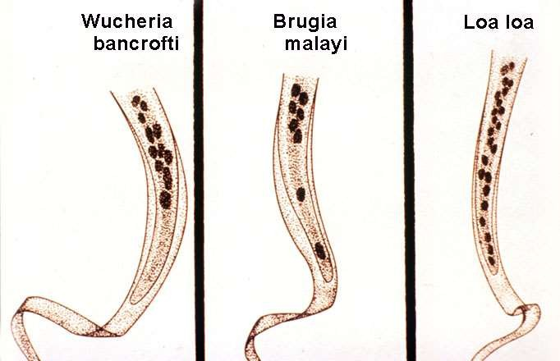
LYMPHATIC FILARIASIS
Wuchereria bancrofti
Brugia malayi
Brugia timoria

Slide 15
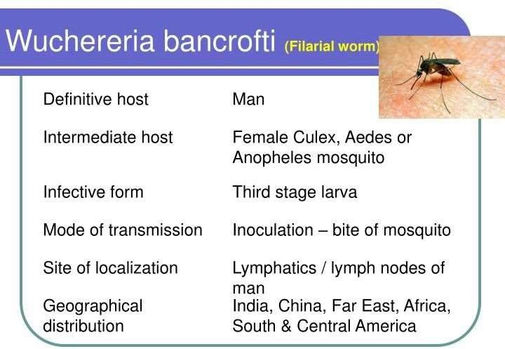

Slide 16
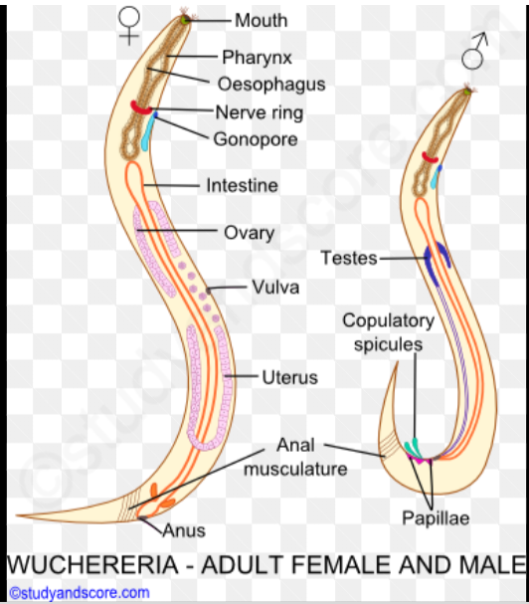

Slide 17
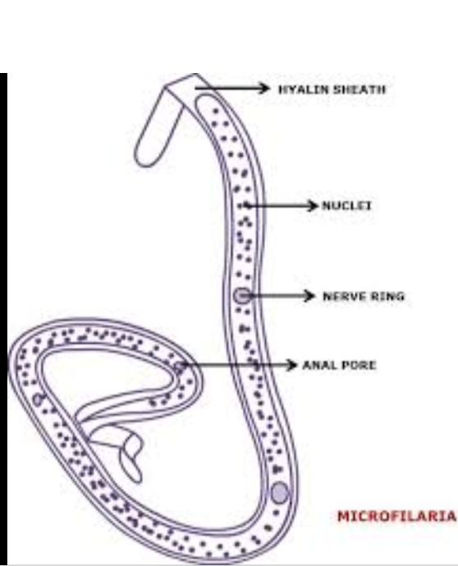

Slide 18
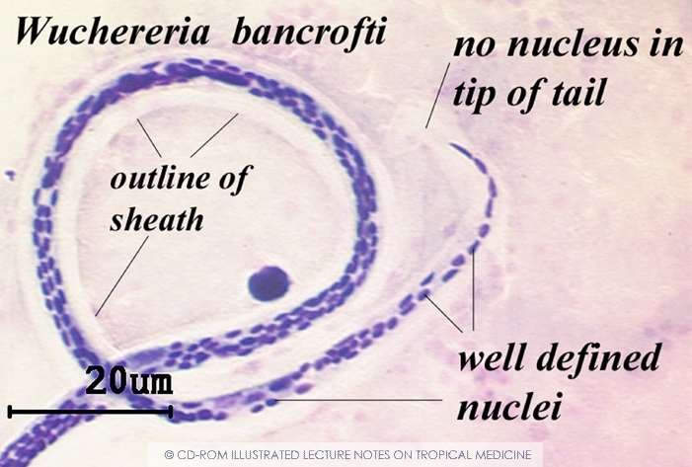
Wuchereria bancrofti

Slide 19
Mode of Transmission & Incubation Period
Lymphatic Filariasis is transmitted by the bite of Infected mosquito which harbours L₃ larva.
L₁: 1-3 hours
L₂: 3-4 days
L₃: 5-6 days
Pre-patent period: (L₃ to Mf) Not known
Clinical Incubation period: 8-16 months

Slide 20
Stages in Lymphatic Filariasis
There are 4 stages :
Asymptomatic amicrofilariaemic stage
Asymptomatic microfilariaemic stage
Stage of Acute manifestation
Stage of Obstructive (Chronic) lesions

Slide 21
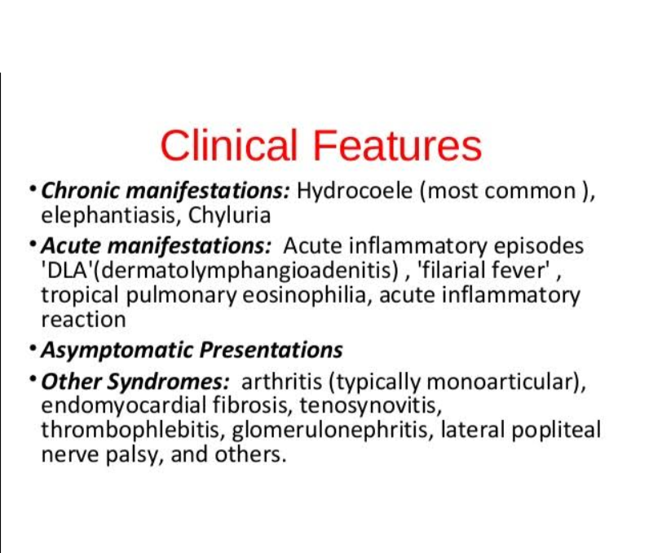

Slide 22
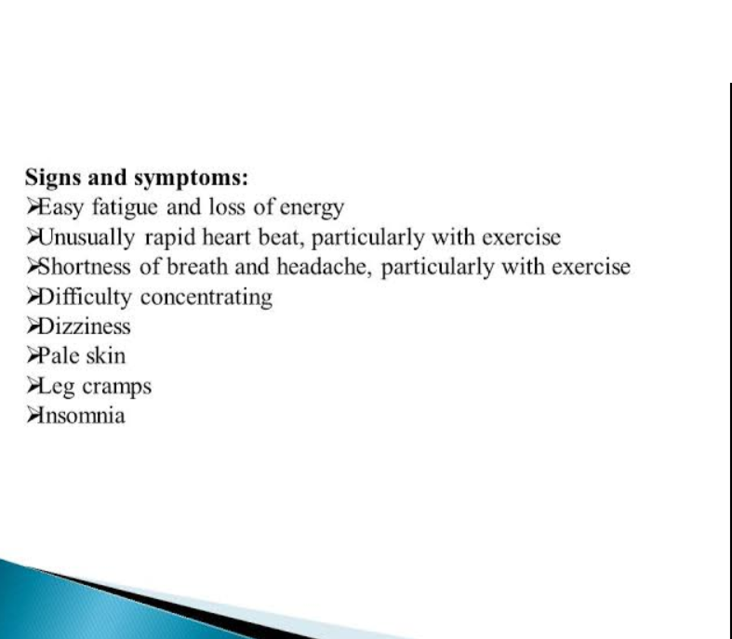

Slide 23
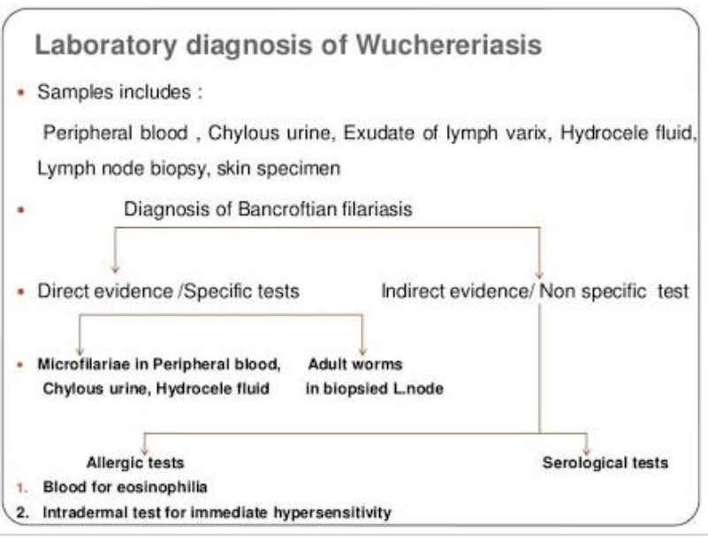

Slide 24
Laboratory Diagnosis
Demonstration of microfilarae in the peripheral blood
  Thick blood smear: 2-3 drops of free flowing blood by finger prick method, stained with JSB-II
  Membrane filtration method: 1-2 ml intravenous blood filtered through 3µm pore size membrane filter
  DEC provocative test (2mg/Kg): After consuming DEC, mf enters into the peripheral blood in day time within 30 - 45 minutes.

Slide 25
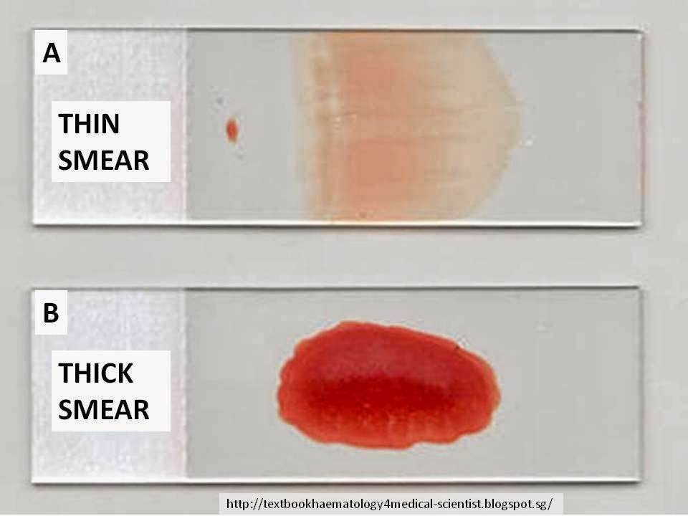
Lab diagnosis

Slide 26
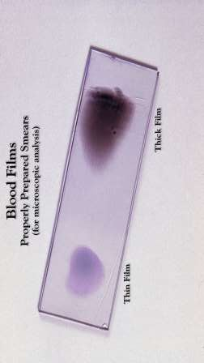
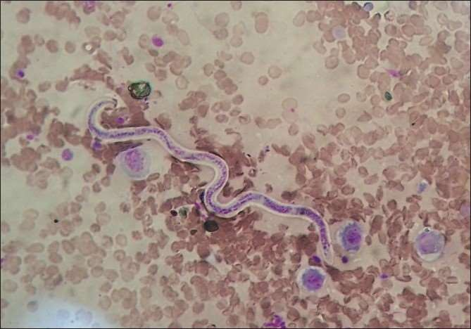
Post DEC Provocation test

Slide 27
2. Immuno Chromatographic Test (ICT): Antigen detection assay can be done by Card test and through ELISA. Circulating Filarial Antigen detection is regarded as “Gold Standard” for diagnosing Wuchereria bancrofti infection. Specificity is near complete, sensitivity is greater than all other parasite detection assays, will detect antigen in amicrofilaraemic as well as with clinical manifestations like lymphoedema, elephantiasis.

Slide 28
3. Quantitative Blood Count (QBC):
QBC will identify the microfilariae and will help in studying the morphology. Though quick it is not sensitive than blood smear examination.
4. Ultrasonography:
Ultrasonography using a 7.5 MHz or 10 MHz probe can locate and visualize the movements of living adult

Slide 29
5. Lymphoscintigraphy:
The structure and function of the lymphatics of the involved limbs can be assessed by lymphoscintigraphy after injecting radio-labelled albumin or dextran in the web space of the toes. The structural changes can be imaged using a Gamma camera. Lymphatic dilation & obstruction can be directly demonstrated even in early clinically asymptomatic stage of the disease.
X-ray Diagnosis:
X-ray are helpful in the diagnosis of Tropical pulmonary eosinophilia.
Picture will show interstial thickening, diffused nodular mottling.
Haematology : Increase in eosinophil count

Slide 30
COMPLICATIONS

Slide 31
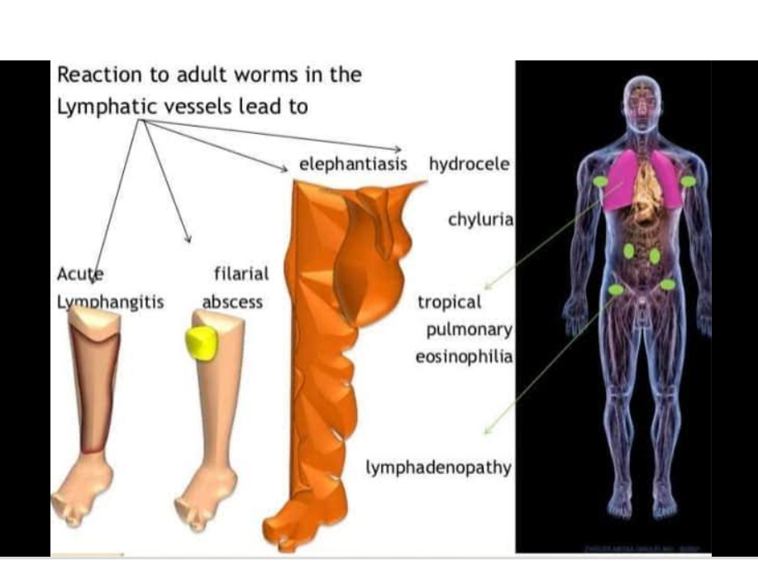

Slide 32
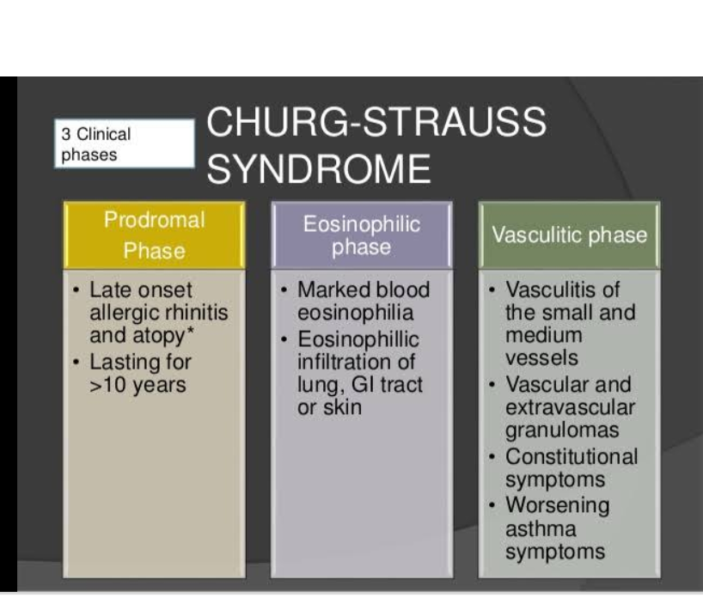

Slide 33
Reference
Essentials of Medical Parasitology Apurba Sankar Sastry
Medical Parasitology K.D Chatterjee

